Slide 1
Collection Framework
import Java.util.*;
package

Slide 2
The Legacy Classes and Interfaces
  Enumeration Interface
  Vector Class
  Stack Class
  Dictionary Abstract Class
  Hashtable Class
  Properties Class

Slide 3
Enumeration Interface
The Enumeration interface defines the methods by which you can enumerate (obtain one at a time) the elements in a collection of objects.
Generic Interface:
interface Enumeration<E>
Enumeration specifies the following two methods:
boolean hasMoreElements( ) - return true while there are still more elements to extract, otherwise false
E nextElement( ) - returns the next object
elements() – used obtain Enumeration from classes

Slide 4
Vector class
implements the List interface
Underlying data structure is resizable array / Dynamic Array
Every method in Vector is Synchronized. Hence vector object is ThreadSafe
Insertion order is preserved
Duplicate objects are allowed
null insertion is possible
Heterogeneous objects are allowed
implements Serializable, Clonable and RandomAccess interfaces
Best suitable if our frequent operation is retrieval
Vector is generic:
class Vector<E>
Vector Constructors:
  Vector( ) //creates a default vector with initial size of 10.(new capacity=2*default size)
  Vector(int size) //creates a vector whose initial capacity is specified by size.
  Vector(int size, int incr) // creates a vector with initial capacity and increment is specified by incr
  Vector(Collection c) //creates a vector that contains the elements of collection c.

Slide 5
Vector class
Vector class has three protected data members:
int capacityIncrement – Used to store increment value
int elementCount - Used to store the number of elements currently in the vector
Object[ ] elementData - Used to store the array that holds the

Slide 6
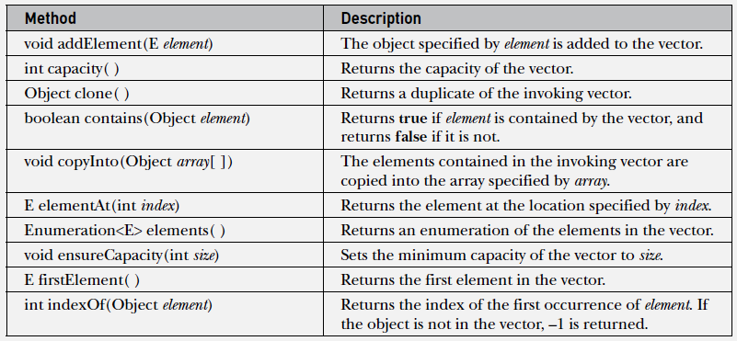
Vector class - Methods
In addition to the methods specified by List interface , Vector defines several methods.

Slide 7
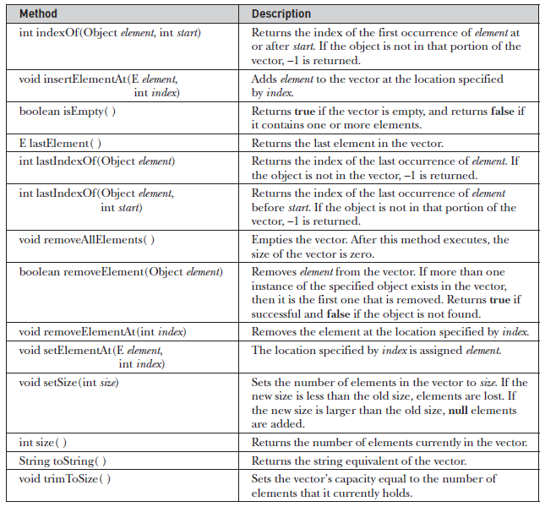
Vector class - Methods

Slide 8
// Demonstrate various Vector operations.
import java.util.*;
class VectorDemo
{
public static void main(String args[])
{
// initial size is 3, increment is 2
Vector<Integer> v = new Vector<Integer>(3, 2);
System.out.println("Initial size: " + v.size());
System.out.println("Initial capacity: " + v.capacity());
v.addElement(1);
v.addElement(2);
v.addElement(3);
v.addElement(4);
System.out.println("Capacity after four additions: " + v.capacity());
v.addElement(5);
System.out.println("Current capacity: " + v.capacity());
v.addElement(6);
v.addElement(7);
System.out.println("Current capacity: " + v.capacity());
System.out.println("First element: " + v.firstElement());
System.out.println("Last element: " + v.lastElement());

Slide 9
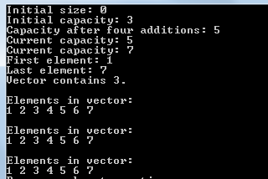
if(v.contains(3))
System.out.println("Vector contains 3.");
// Enumerate the elements in the vector.
Enumeration<Integer> vEnum = v.elements();
System.out.println("\nElements in vector:");
while(vEnum.hasMoreElements())
System.out.print(vEnum.nextElement() + " ");
System.out.println();
// Use an iterator to display contents.
Iterator<Integer> vItr = v.iterator();
System.out.println("\nElements in vector:");
while(vItr.hasNext())
System.out.print(vItr.next() + " ");
System.out.println();
// Use an enhanced for loop to display contents
System.out.println("\nElements in vector:");
for(int i : v)
System.out.print(i + " ");
System.out.println();
}
}

Slide 10
Vector class
Vector is similar to ArrayList, but with two difference:
  Vectors are synchronized by default , ArrayLists are not.
  Vector increments 100% means doubles the array size if total number of element exceeds than its capacity, but ArrayList increments 50% of current array size if number of element exceeds from its capacity.

Slide 11
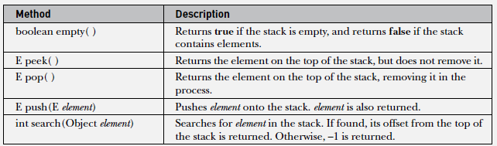
Stack class
Stack is a subclass of Vector that implements a standard last-in, first-out stack.
Stack is generic class:
class Stack<E>
Constructor:
Stack()
Stack includes all the methods defined by Vector and adds several of its own.

Slide 12
// Demonstrate the Stack class.
import java.util.*;
class StackDemo
{
static void showpush(Stack<Integer> st, int a)
{
st.push(a);
System.out.println("push(" + a + ")");
System.out.println("stack: " + st);
}
static void showpop(Stack<Integer> st)
{
System.out.print("pop -> ");
Integer a = st.pop();
System.out.println(a);
System.out.println("stack: " + st);
}

Slide 13
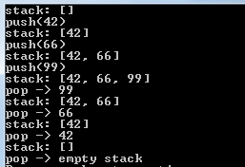
public static void main(String args[])
{
Stack<Integer> st = new Stack<Integer>();
System.out.println("stack: " + st);
showpush(st, 42);
showpush(st, 66);
showpush(st, 99);
showpop(st);
showpop(st);
showpop(st);
try
{
showpop(st);
}
catch (EmptyStackException e)
{
System.out.println("empty stack");
}
}
}

Slide 14
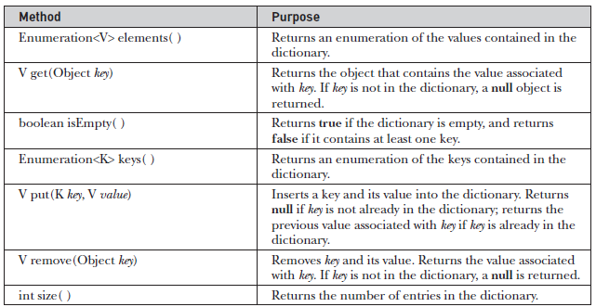
Dictionary Abstract class
A dictionary is a list of key/value pairs
Dictionary is an abstract class operates much like Map.
Given a key and value, you can store the value in a Dictionary object.
Once the value is stored, you can retrieve it by using its key.
Dictionary generic. :
class Dictionary<K, V>
The abstract methods defined by Dictionary are.

Slide 15
Hashtable class
Hashtable is a concrete implementation of a Dictionary.
Hashtable implements the Map interface.
Hashtable is similar to HashMap, but is synchronized(all methods).
Like HashMap, Hashtable stores key/value pairs in a hash table.
Neither keys nor values can be null.
When using a Hashtable, we specify an object that is used as a key, and the value that we want to link to that key. The key is then hashed, and the resulting hash code is used as the index at which the value is stored within the table.
Hashtable was generic :
class Hashtable<K, V>
Constructors:
Hashtable( ) // Initial default size 0.75
Hashtable(int size)
Hashtable(int size, float fillRatio) // fill ratio between 0.0 to 1.0 default 0.75
Hashtable(Map<? extends K, ? extends V> m)

Slide 16
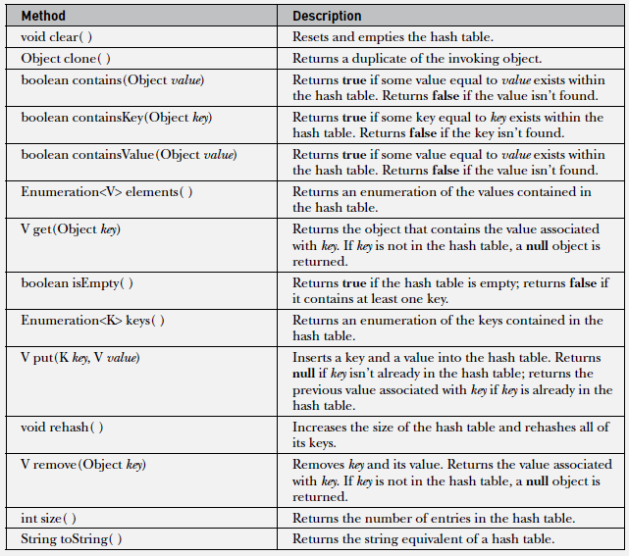
Hashtable class - Methods

Slide 17
// Demonstrate a Hashtable.
import java.util.*;
class HTDemo
{
public static void main(String args[])
{
Hashtable<String, Double> balance = new Hashtable<String, Double>();
Enumeration<String> names;
String str;
double bal;
balance.put("vijay", 3434.34);
balance.put("Kumar", 123.22);
balance.put("shekhar", 1378.00);
balance.put("akhila", 99.22);
balance.put("keshav", -19.08);
// Show all balances in hashtable.
names = balance.keys();
while(names.hasMoreElements())
{
str = names.nextElement();
System.out.println(str + ": " +
balance.get(str));
} System.out.println();

Slide 18

// Deposit 1,000 into vijay's account.
bal = balance.get("vijay");
balance.put("vijay", bal+1000);
System.out.println("vijay's new balance: " +
balance.get("vijay"));
}
}
Note:
Like the map classes, Hashtable does not directly support iterators.
we can obtain set-view or collection-view of the hash table by using one of the methods entrySet( ) or keySet( ), which permits the use of iterators.

Slide 19
Properties class
Properties is a subclass of Hashtable.
Properties class is used to maintain lists of values in which the key is a String and the value is also a String.
The Properties class, itself, is not generic, several of its methods are generic.
Properties defines the following instance variable:
Properties defaults; - This variable holds a default property list associated with a Properties object.
Constructors:
Properties( ) - creates a Properties object that has no default values
Properties(Properties propDefault) - creates an object that uses propDefault for its default values

Slide 20
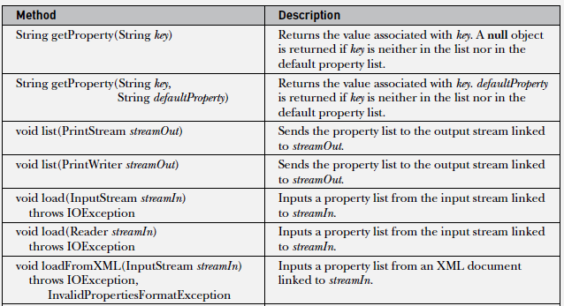
Properties class - Methods

Slide 21
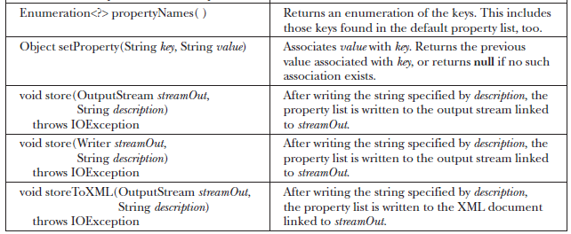

Properties class - Methods

Slide 22

// Demonstrate a Property list.
import java.util.*;
class PropDemo
{
public static void main(String args[])
{
Properties capitals = new Properties();
capitals.put("Telangana", "Hyderabad");
capitals.put("Andhra Pradesh", "Amaravathi");
capitals.put("Karnataka", "Bangalore");
capitals.put("Tamilnadu", "Chennai");
// Get a set-view of the keys.
Set<?> states = capitals.keySet();
// Show all of the states and capitals.
for(Object name : states)
System.out.println("The capital of " + name + " is " + capitals.getProperty((String)name)+ ".");
System.out.println();
// Look for state not in list -- specify default.
String str = capitals.getProperty("Delhi", "Not Found");
System.out.println("The capital of Delhi is " + str + ".");
} }

Slide 23
//In the above program we can create Properties with defaults
Properties defList = new Properties();
defList.put(“Delhi", “Noida");
defList.put(“Goa", “pattaya");
Properties capitals = new Properties(defList);
//The n we will be able to find Delhi capital
String str = capitals.getProperty(“Delhi");
System.out.println("The capital of Delhi is “ + str + ".");

Slide 24
Task
Develop a program which uses strore() and load() methods of Properties class.

